Slide 1
CSA0695-DESIGN AND ANALYSIS OF ALGORITHM FOR OPEN ADDRESSING TECHNIQUES
DIVIDE AND CONQUER-VALID PAIR ARRANGEMENTS
SIMATS-SAVEETHA SCHOOL OF ENGINEERING
CHENNAI-602105
Project By Guided By
P.CHANDANA Dr. R. DHANALAKSHMI
(192210505)
CSE

Slide 2


Valid Pair Arrangements
This project focuses on finding valid arrangements of pairs, exploring the complexities and potential applications of this problem. The aim is to develop efficient algorithms and analyze the challenges associated with determining valid configurations.

Slide 3


Problem Statement
1
Definition
2
Constraints
Given a set of objects, determine if they can be arranged into pairs where each object belongs to exactly one pair.
The arrangement must satisfy specific constraints, such as compatibility between objects or the order in which they are paired.
3
Applications
4
Example
This problem has applications in fields like resource allocation, scheduling, and computer networking.
Arranging people for a dance competition where each person must be partnered with one other person.

Slide 4


Abstract
Goal
Methodology
To develop efficient algorithms for finding valid arrangements of pairs while satisfying given constraints.
We explore graph theory concepts and apply combinatorial techniques to analyze the problem's complexity.
Results
Contribution
We identify key properties of valid arrangements and demonstrate the effectiveness of our algorithms through practical examples.
Our work contributes to the understanding of pair arrangement problems and provides valuable insights for real-world applications.

Slide 5
Introduction
Pair Arrangement
Valid Arrangements
Applications
The problem of arranging objects into pairs is a fundamental concept in computer science and mathematics.
A valid arrangement satisfies specific criteria, such as compatibility between objects or a predefined order.
Applications range from scheduling tasks to allocating resources in networks, highlighting its practical relevance.

Slide 6
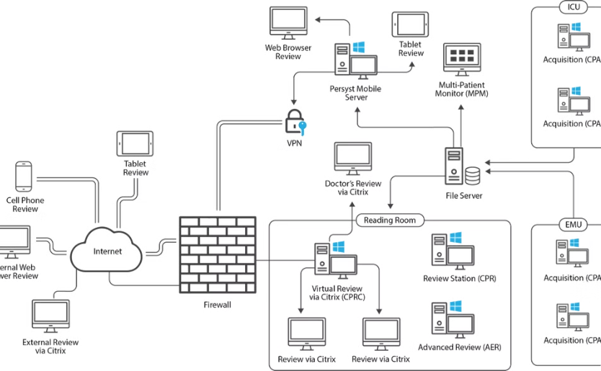

Architecture Diagram
Graph Representation
Algorithm
The problem can be modeled as a graph, where nodes represent objects and edges represent potential pairs.
Algorithms like Depth-First Search (DFS) or Breadth-First Search (BFS) can be used to explore the graph and find valid arrangements.

Slide 7


Sample Output
Object 1
Object 2
A
B
C
D
E
F

Slide 8


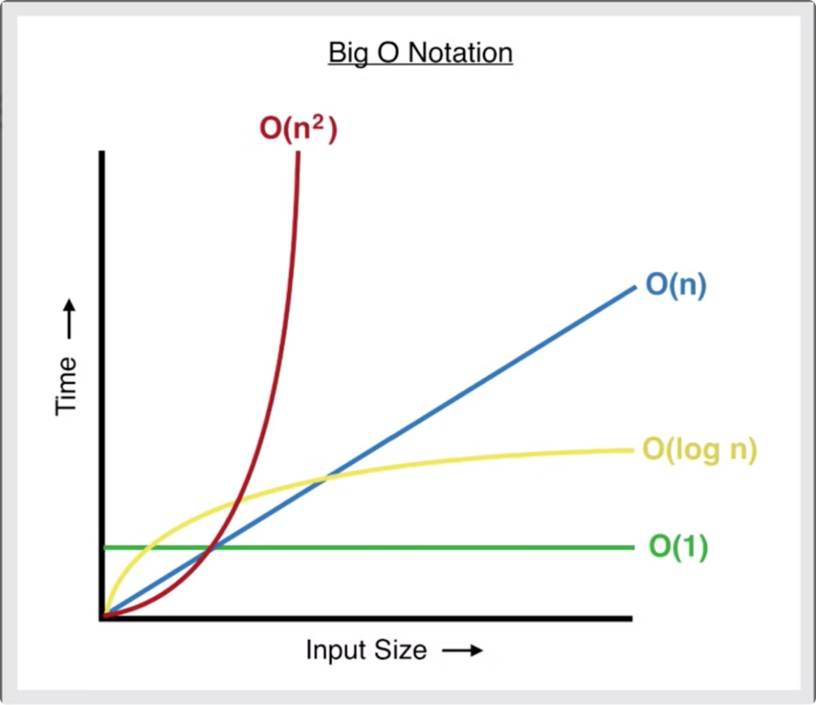
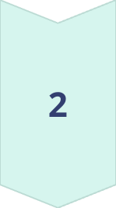

Complexity Analysis
Time Complexity
The time complexity of finding valid arrangements depends on the algorithm used and the size of the input.
Space Complexity
The space complexity is determined by the amount of memory required to store the graph and intermediate results.
Optimization Techniques
Techniques like heuristics and pruning can be used to improve the efficiency of algorithms.

Slide 9

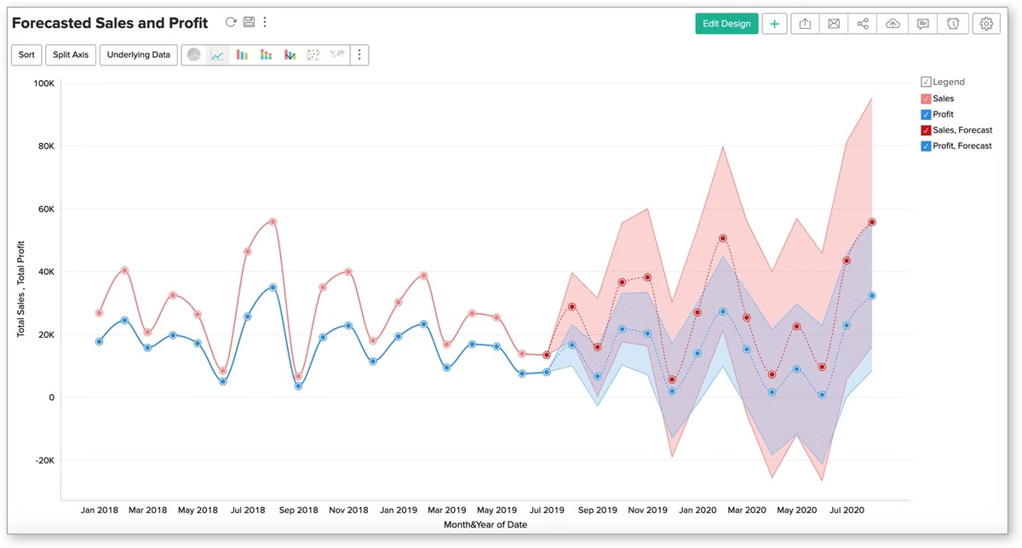
Future Scope
1
Dynamic Constraints
2
Large-Scale Arrangements
Exploring scenarios where constraints can change over time and the need for adaptive algorithms.
Developing scalable algorithms to handle large numbers of objects and complex constraints.
3
Parallel Computing
4
Machine Learning
Investigating the use of parallel computing techniques to speed up the process of finding valid arrangements.
Exploring the use of machine learning to identify patterns in valid arrangements and predict optimal configurations.

Slide 10






Applications of Valid Arrangements
Scheduling
Resource Allocation
Arranging tasks or appointments into pairs based on time constraints and dependencies.
Allocating resources like servers or bandwidth to users in a network based on their requirements.
Team Formation
Game Development
Matching team members for projects based on their skills and compatibility.
Creating game levels or scenarios where characters or objects need to be paired based on rules and logic.

Slide 11


Challenges in Finding Valid Arrangements
1
Constraint Complexity
2
Large Input Size
Dealing with large numbers of objects and constraints can lead to computational challenges.
The complexity of constraints can significantly affect the difficulty of finding valid arrangements.
3
Dynamic Constraints
4
Optimization Goals
Adapting to changes in constraints over time requires algorithms that can handle dynamic updates.
Finding not just any valid arrangement, but the best arrangement based on specific optimization criteria can be complex.

Slide 12


Conclusion and Key Takeaways
1
Importance
2
Algorithm Development
Finding valid arrangements is a fundamental problem with wide-ranging applications in various domains.
Efficient algorithms are crucial for solving this problem, especially when dealing with large-scale instances.
3
Future Directions
4
Impact
Further research is needed to address challenges related to dynamic constraints, scalability, and optimization.
This research provides valuable insights and potential solutions for improving efficiency and effectiveness in real-world applications.

Slide 13


